Slide 1
Activity 11 - Basic Video Processing
de Castro, Crizzia Mielle | 2015-08076

Slide 2
Converting mp4 Video to png Frames
We took a video of a clock. My goal is to find the angular speed of the seconds hand and compare it to the theoretical value of 6º/sec or 𝜋/30 rad/sec. The first step is to convert the video we took to png images. I used an online converter: filezigzag.com. This was suggested by my classmate, Reinier Ramos. A six-second clip of a ticking clock was converted into 64 frames. An animated gif of the 64 frames is shown below.

Slide 3
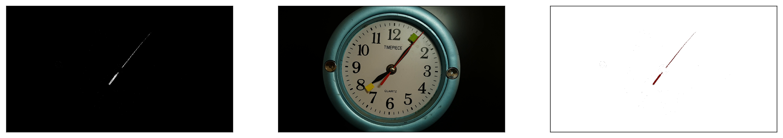
Nonparametric Segmentation
I used nonparametric segmentation to separate the seconds hand from the other parts of the image. The patch I used came from the shorter tip of the seconds hand. The segmented image (leftmost) is barely visible, so I performed morphological operations to make it clearer.

Slide 4
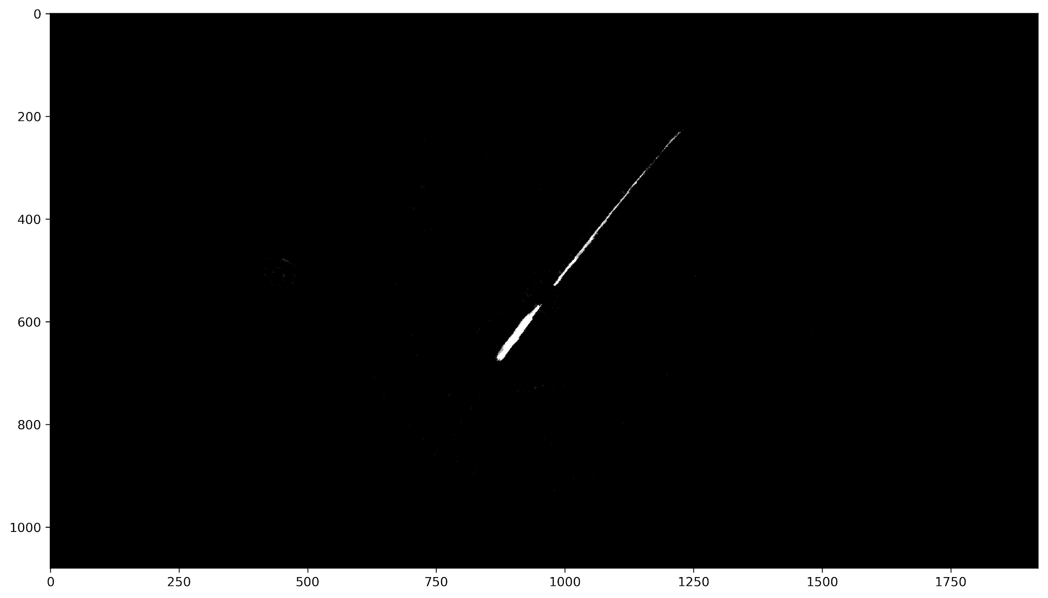
Morphological Operations
I used OpenCV’s closing morphological operation to clean the image. I used a 5x5 cross as my structuring element. I found that the optimal number of iterations to obtain a clean image is 3 iterations.

Slide 5
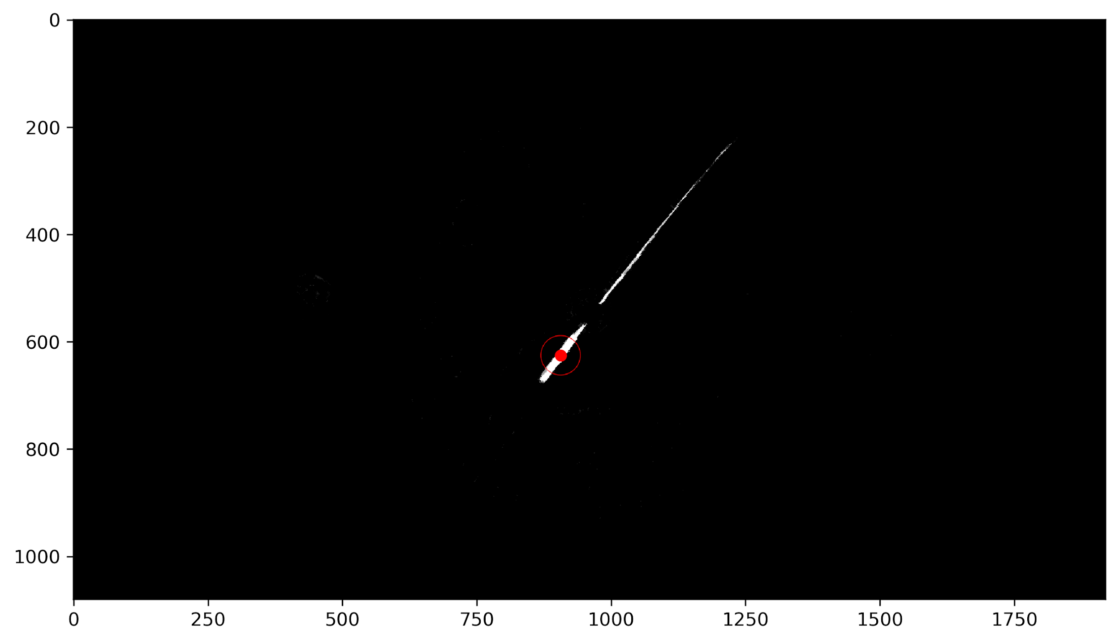
Blob Detection
Parameters
blobColor = 255
minArea = 300
minCircularity = 0.1
minConvexity = 0.001
minInertiaRatio = 0.0001
The wider part of the seconds hand looks like an elongated and thin blob. Thus, I applied blob detection to obtain its centroid. Its centroid will serve as my reference point for each frame. The enlarged red dot in the image is its centroid. Adjusting the minArea is important for the detector to only choose the wider part and not unnecesary noisy blobs.

Slide 6
Animation of Clock Ticking
I repeated the processes from nonparametric segmentation to blob detection on all 64 frames of the video. The animation of the results is shown above.

Slide 7
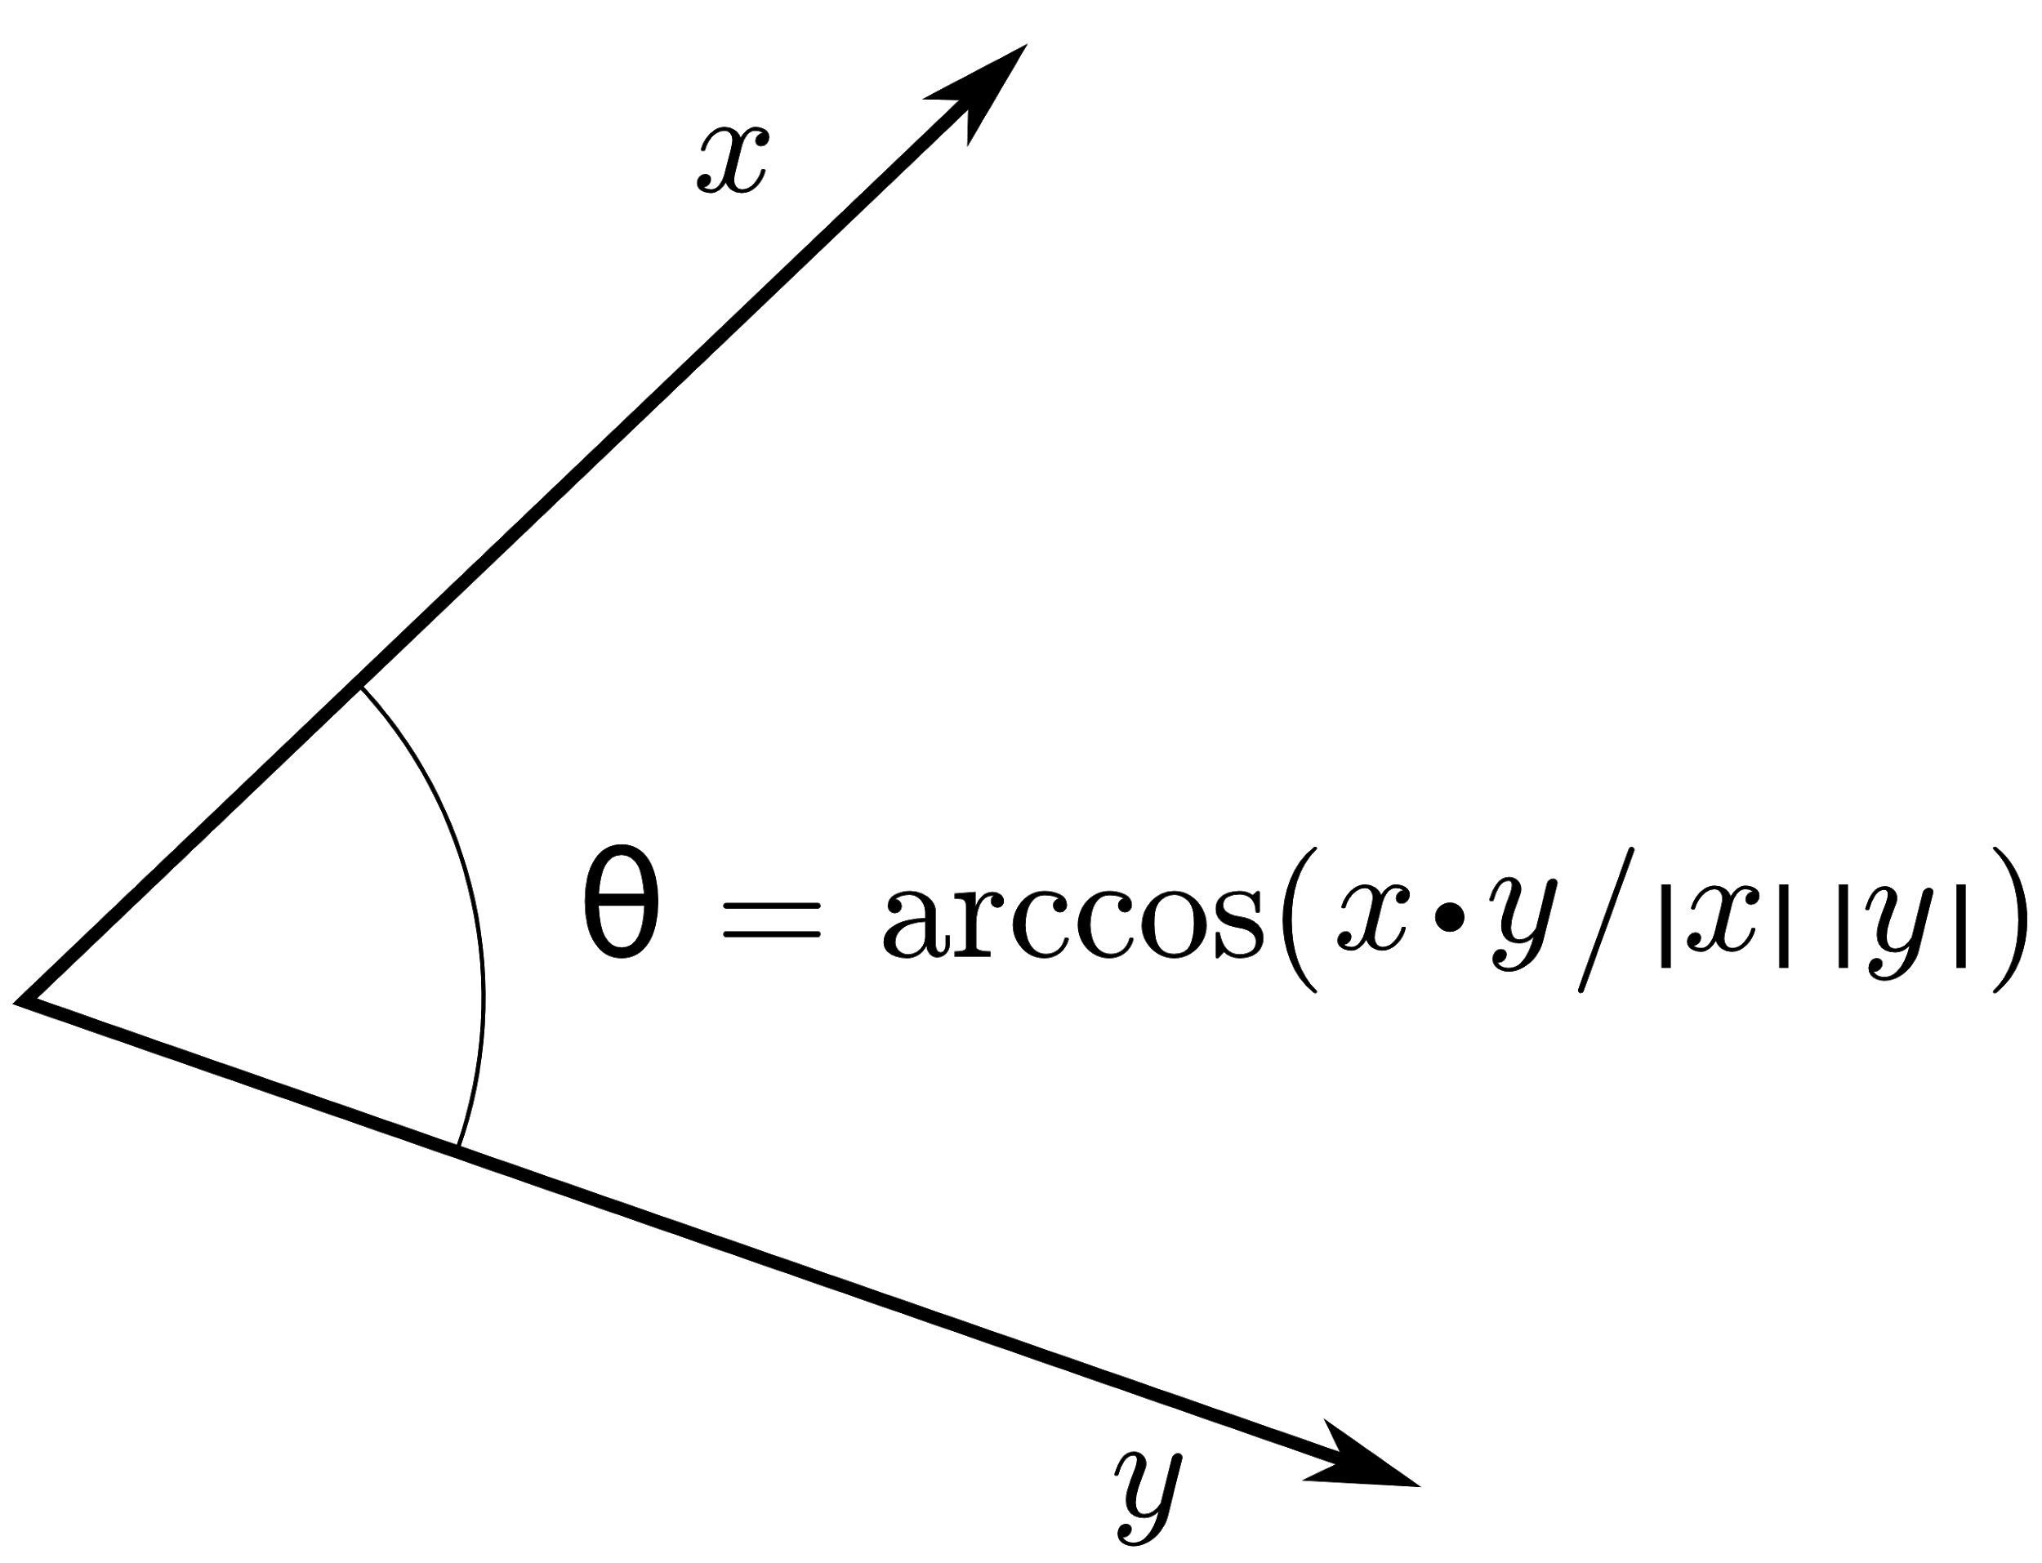
Calculating angular displacement of seconds hand
To calculate the angular displacement, I used the definition of a dot product. Jom Macalintal suggested this to me. This calculates the angle difference (in radians) of the centroids in succeeding frames. To obtain x and y, I have to first subtract the centroid coordinates from the coordinates of the center of the clock. I determined the center of the clock using Gimp.

Slide 8
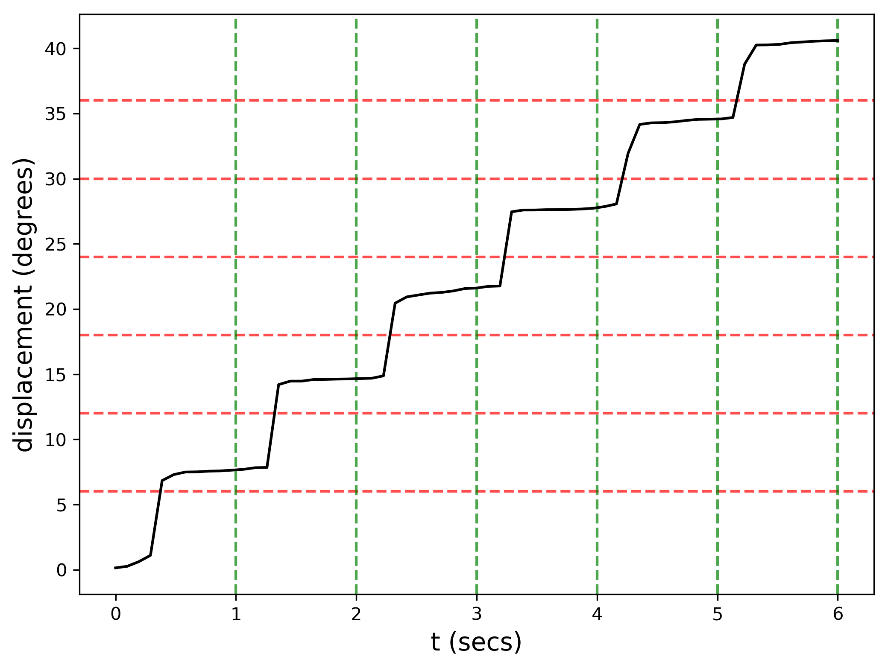
Calculating angular displacement of seconds hand
The displacement in radians from the original position of the seconds hand was obtained from the cumulative sum of the angle differences. Its displacement over time is shown below. This was in the course of 64 frames for 6 seconds. The plateau in the plot should match the red dashed lines, while the step should match the green dashed lines. Theoretically, it’s step should be at each second, and the plateaus should be every 6 degrees.

Slide 9
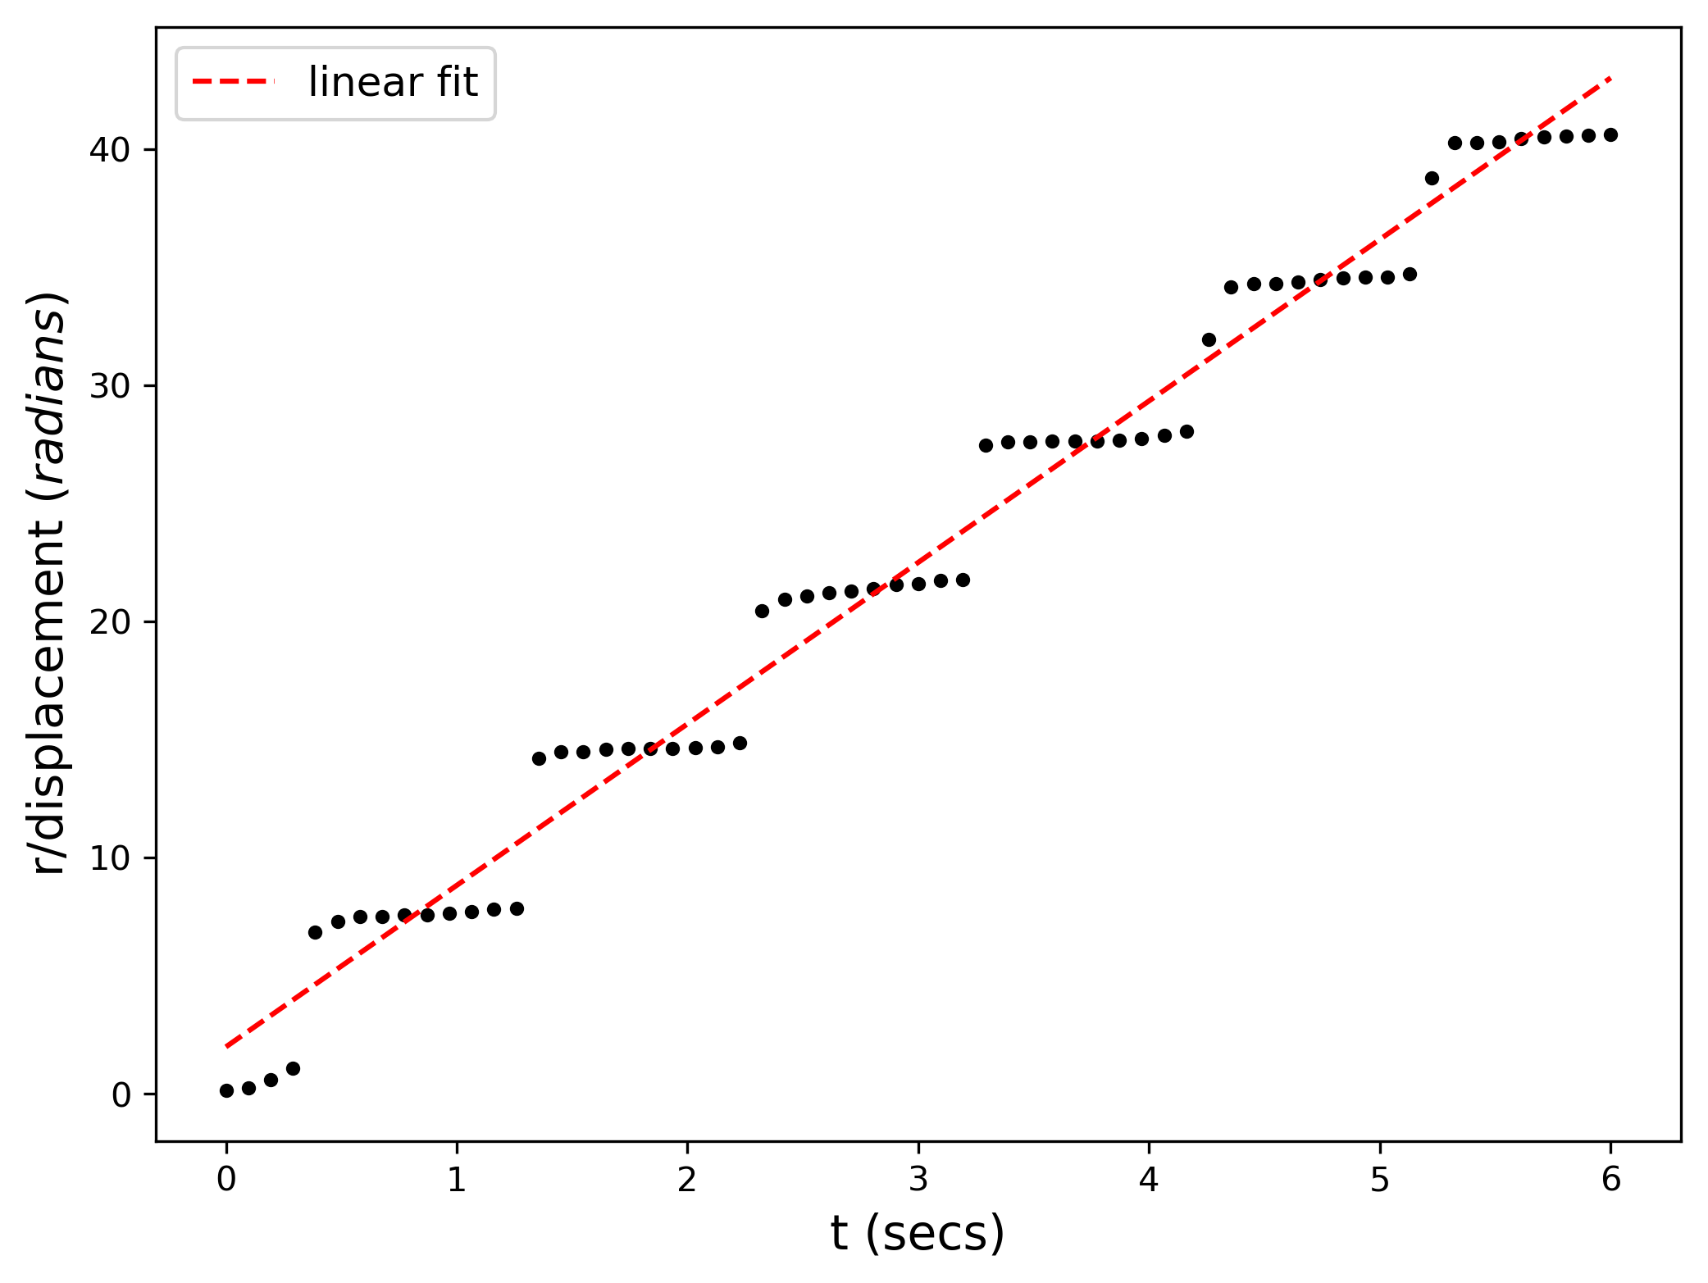
Calculating angular speed of seconds hand
I tried fitting a linear plot over the displacement to obtain its slope. Theoretically, it should be 6 degrees/sec. From here, the slope I got was 6.84, which deviates by 13.9%.

Slide 10
Possible reasons for errors in results
Other way to improve experiment
The clipping of the video did not start at the exact beginning of the first second and did not end at the exact end of the 6th second.
The online video to image frames converter I used tends to be inconsistent in creating its frames.
There are clocks whose seconds has move continuously and do not tick. It would be nice to try these kinds of clocks, so that the plot of the displacement over time is linear instead of a step function.

